Slide 1


The OPEN Government Data Act:
A Catalyst for Transparency and Innovation
Presented by: Hamza Siddiqui

Slide 2
TABLE OF CONTENTS
01
02
03
04
Objectives of the Act
Impact of Data Management
Relation to Federal Data Strategy
Potential Challenges
Data& Society

Slide 3
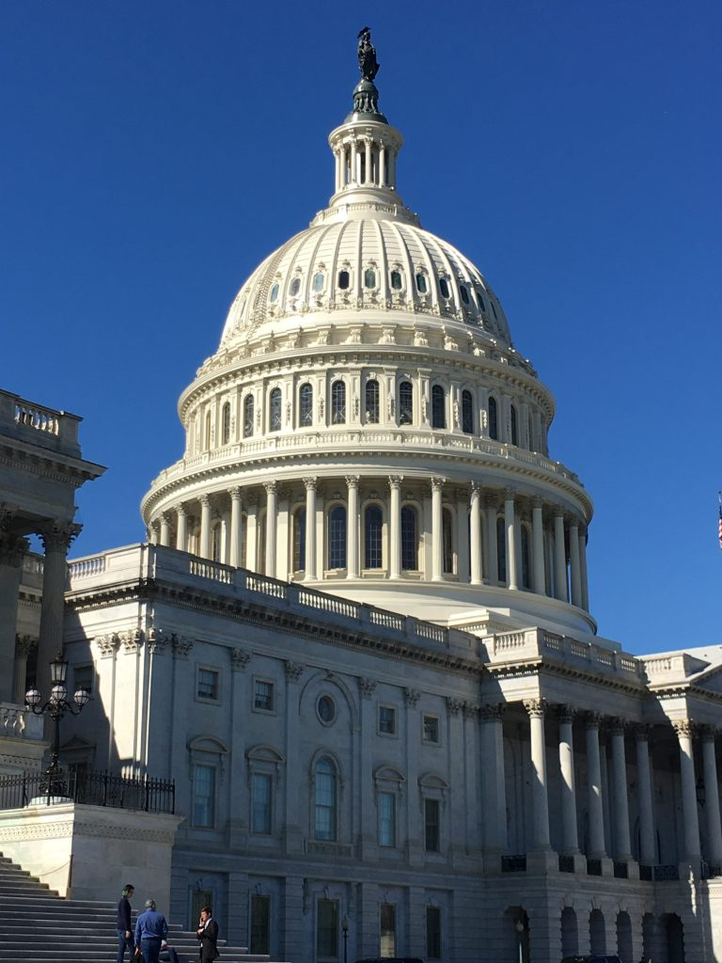
01
Key Objectives
of the Open Government Data Act

Slide 4
Enhanced Transparency and Accountability: By making government data publicly available, the Act promotes transparency and accountability in government operations. Citizens, journalists, and researchers can now scrutinize government activities and identify potential issues.
Stimulated Innovation and Economic Growth: Open data can fuel innovation by providing businesses, entrepreneurs, and researchers with valuable data to develop new products, services, and insights.
Improved Government Efficiency: By promoting data-driven decision-making and identifying opportunities for automation, the Act can help agencies operate more efficiently and effectively.
Notes:
The Federal Data Strategy, introduced through Memorandum M-19-18, outlines how federal agencies should manage and use data to deliver better services and outcomes by 2030.
It aligns federal data use with emerging priorities like privacy, security, and evidence-based policymaking.
Foundational Activities (2020-2022): Focus on governance, infrastructure, and planning to set a strong baseline.
Enterprise Activities (2023-2025): Establish data standards and align budgets with long-term data strategies.
Optimized Activities (2026-2028): Enable self-service analytics to empower stakeholders.
Data-Driven Activities (2029-2030): Realize automated, proactive decision-making through advanced data practices.
2021 Action Plan:
2021 builds on the successes of 2020. Agencies are focused on:
Strengthening governance bodies and planning.
Addressing data maturity and filling skill gaps.
Standardizing best practices to ensure scalability.
Role of CDOs and the Chief Data Officer Council in coordinating efforts across agencies.
FDS aims for consistency and integration—ensuring that every federal agency operates with robust, standardized data practices.
A note on flexibility, the FDS accommodates varying levels of agency data maturity and evolving priorities.

Slide 5

02
Impact of Data Management

Slide 6
Impact of Data Management
Enterprise Data Inventory
Open Data Standards
The Act mandates the creation and maintenance of a comprehensive inventory of government data assets, improving data management and facilitating data sharing.
The Act promotes the use of open data formats and standards, making data more accessible and interoperable
01
02
02
Strengthened Role of CIOs
Data Sharing and Release
Agencies are encouraged to make data publicly available under open licenses, unless there are legitimate privacy or security concerns.
03
04
Chief Information Officers (CIOs) are given increased responsibility for data management, ensuring data quality, security, and accessibility.
Notes:
Governance Successes:
The CDO Council created a collaborative environment to standardize governance practices.
Initiatives like the COVID-19 Working Group addressed real-time challenges using cross-agency data collaboration.
Planning Successes:
Maturity assessments provided a roadmap for agencies to improve their data governance and operations.
Data upskilling programs, like the pilot cohort of 61 federal employees, addressed workforce gaps.
Infrastructure Successes:
Agencies indexed data assets on Data.gov, making them accessible and actionable for the public and researchers.
Pilot tools like the One-Stop Researcher Application, which streamline data management and access.
Lessons Learned:
Importance of flexibility, as agencies have varying levels of maturity and resources. Collaboration through councils like the CDO Council ensures shared learning.
Aligning milestones with budget cycles prevents delays and facilitates long-term planning.

Slide 7

03
Relation to Broader
Federal Data Strategy

Slide 8
Relation to Broader
Federal Data Strategy
Promoting Data-Driven Government: Encouraging the use of data to inform decision-making and improve service delivery.
Fostering Interagency Collaboration: Promoting data sharing and collaboration among agencies.
Building Public Trust: By making government data more accessible, the Act can increase public trust in government.

Slide 9
04
Potential Challenges from the OPEN Government Data Act

Slide 10
Potential Challenges
Data Quality and Consistency: Ensuring the quality, accuracy, and consistency of government data can be a complex and ongoing challenge.
Privacy and Security Concerns: Balancing the need for open data with privacy and security concerns requires careful consideration and appropriate safeguards.
Technical Challenges: Implementing open data initiatives can require significant technical expertise and investment in data infrastructure.
Cultural Change: Shifting to a culture of data-driven decision-making and open data requires a change in mindset and behavior among government employees.
Notes:
Data Quality and Consistency
Inconsistency in Data Standards: Different agencies may use different data standards and formats, making it difficult to integrate and analyze data across various sources.
Data Quality Issues: Ensuring data accuracy, completeness, and timeliness can be challenging, especially for legacy systems and manual data entry processes.
Data Cleaning and Preparation: Data often requires cleaning, normalization, and standardization before it can be effectively used for analysis and insights.
Privacy and Security Concerns
Protecting Sensitive Information: Balancing the need for open data with the need to protect sensitive personal information requires careful consideration.
Cybersecurity Risks: Making data publicly accessible can increase the risk of cyberattacks and data breaches.
Compliance with Privacy Regulations: Agencies must comply with various privacy regulations, such as HIPAA and FERPA, while making data available.
Technical Challenges
Data Infrastructure and Technology: Implementing open data initiatives requires significant investment in data infrastructure, technology, and skilled personnel.
Data Management and Governance: Establishing effective data management practices and governance structures is crucial for ensuring data quality, security, and accessibility.
Interoperability: Ensuring that different data systems and formats can interoperate seamlessly is a complex technical challenge.
Cultural Change
Resistance to Change: Some agencies may be resistant to sharing data, due to concerns about accountability, transparency, or resource constraints.
Data Literacy and Skills: Building a data-literate workforce is essential for effectively using and managing data.
Data-Driven Culture: Fostering a culture of data-driven decision-making requires a shift in mindset and behavior among government employees.

Slide 11

THANKS!
Do you have any questions?
hssiddiqui99@gmail.com (832) 782-9837
Hamza Siddiqui
Data& Society

